Slide 1

Baseband Signals and AM/FM Signals

Slide 2
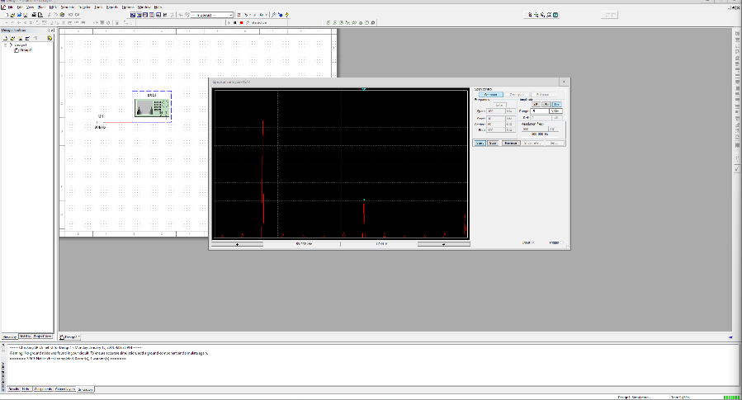
Baseband Signals
The screenshot should show the spectrum analyzer displaying the signal’s harmonic spectrum and its panel settings. Record the signal voltage at each of the frequencies in the table.
SCREENSHOT HERE
Harmonic Frequency | Signal (Volts)
20 kHz | 3.089v
40 kHz | 0 V
60 kHz | 1.045 V
80 kHz | 2.04 uV
100 kHz | 594.3 mV

Slide 3
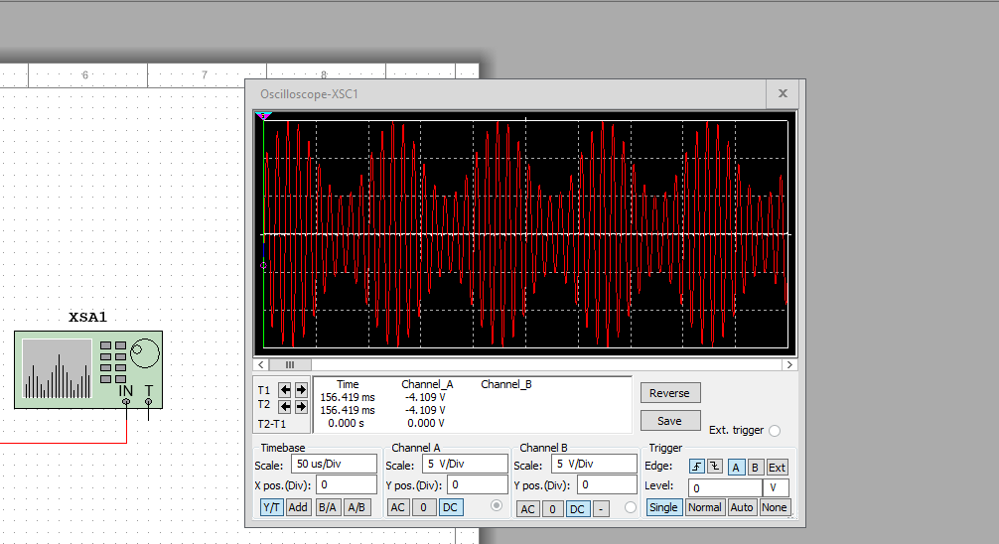
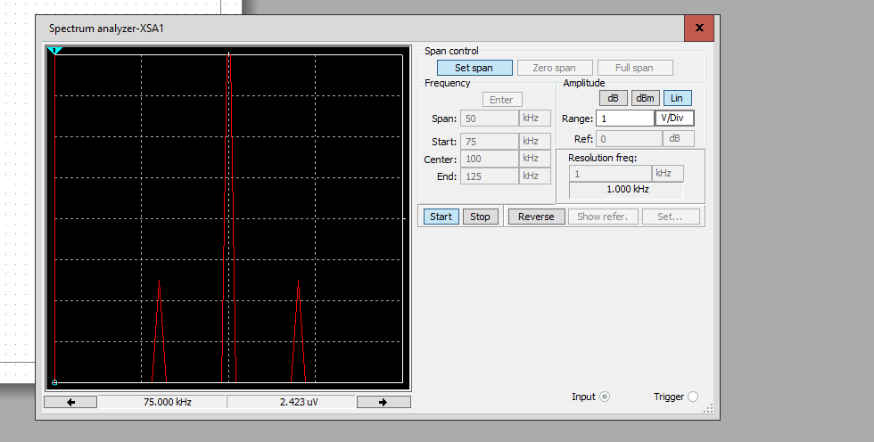
AM Signals
The screenshot of the Oscilloscope should include the signal and the panel settings of the oscilloscope. The screenshot of the Spectrum Analyzer should include the signal and the panel setting of the analyzer.
Oscilloscope screenshot here
Spectrum Analyzer screenshot here
AM Modulation | Frequency (kHz)
Lower side band | 90kHz
Carrier | 100kHz
Upper side band | 110

Slide 4
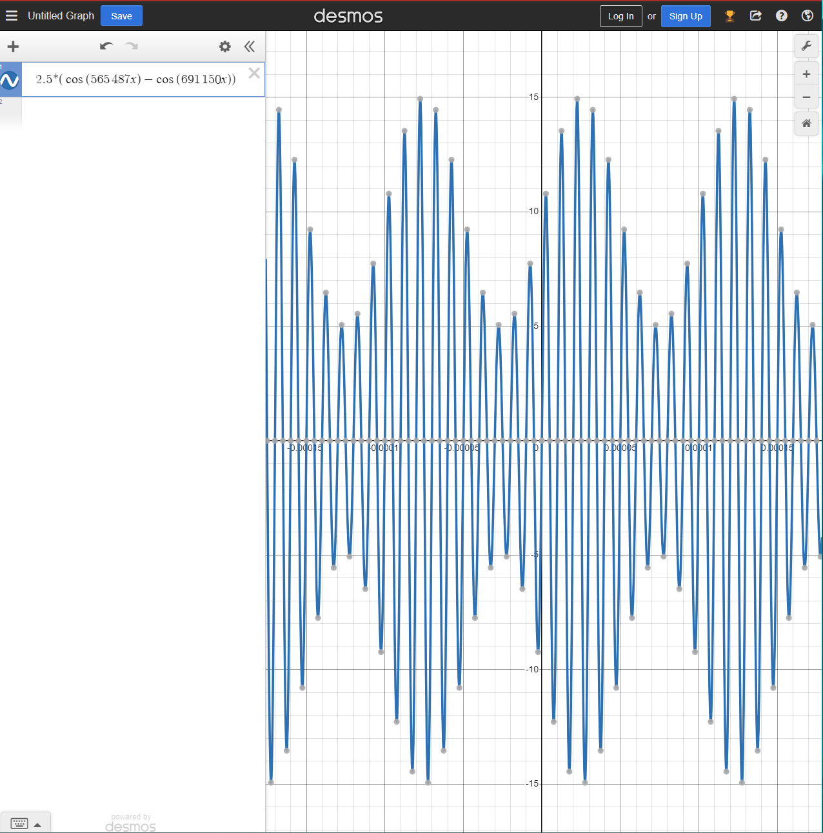
AM Signals Cont.
Develop equations for the carrier and modulating signals and plot the equation for the composite modulated signal V_{AM .}
Equations here:
Vc = 10 sin(2π(100 KHz)t)
Vm = 5 sin(2π(10 KHz)t)
Plotted diagram screenshot here:

Slide 5
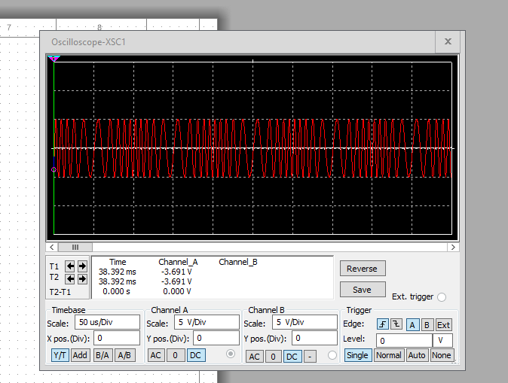
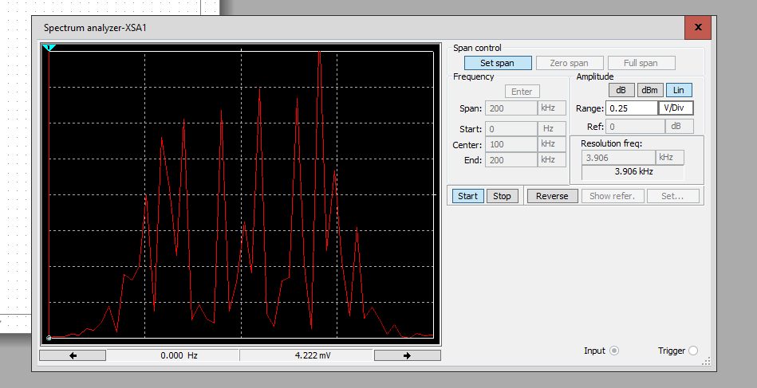
FM Signals
The screenshot of the Oscilloscope should include the signal and the panel settings of the oscilloscope. The screenshot of the Spectrum Analyzer should include the signal and the panel setting of the analyzer.
Oscilloscope screenshot here
Spectrum Analyzer screenshot here
What’s the carrier frequency?
100Khz and 532.397mV

Slide 6
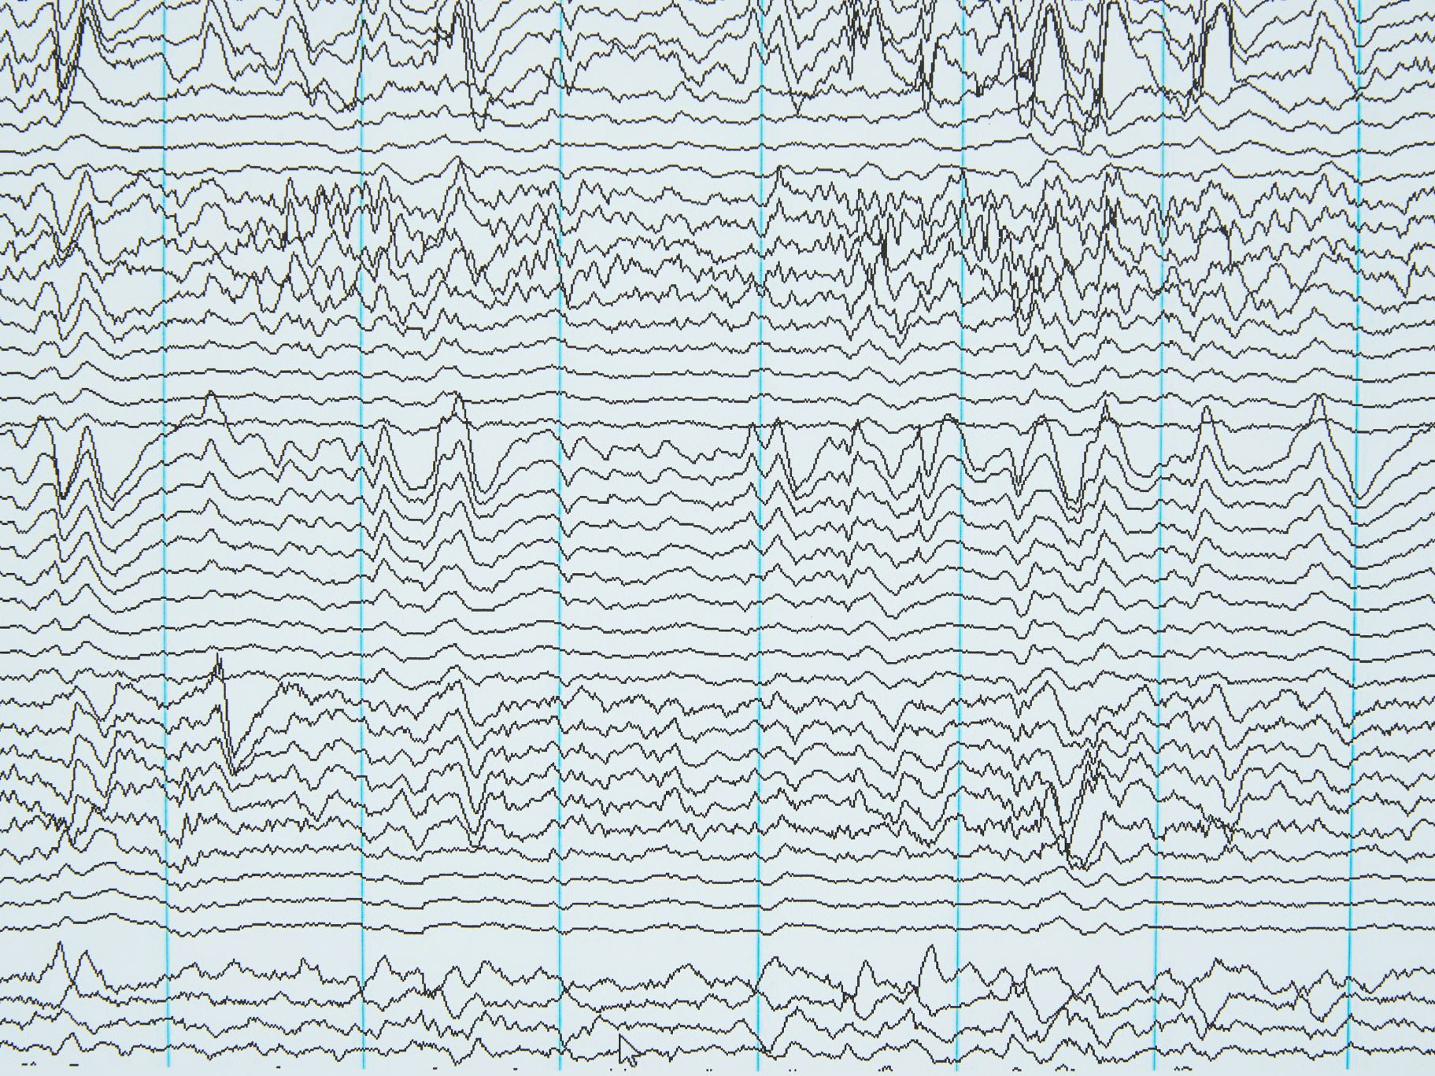
Pulse Code Modulation (PCM) and Line Codes

Slide 7
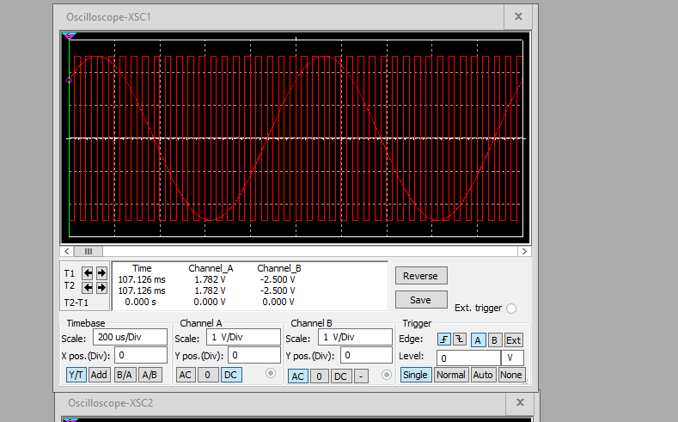
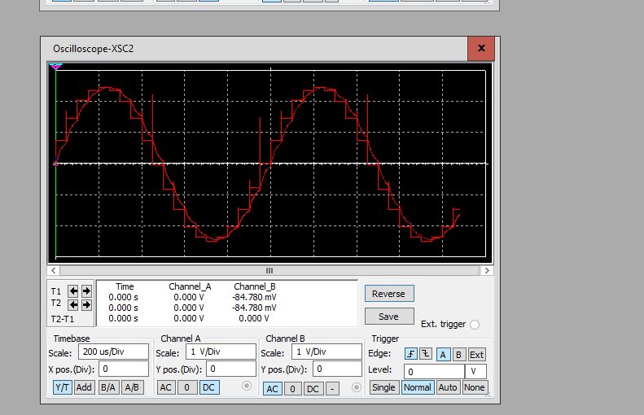
Pulse Code Modulation (PCM)
The first screenshot should show the Oscilloscope-XSC1 display with the analog input signal and sampling clock at the input to the ADC. The second screenshot should show the Oscilloscope-XSC2 display with the output of the DAC.

Slide 8
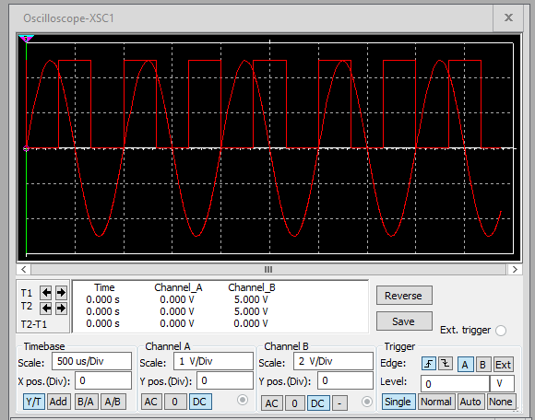
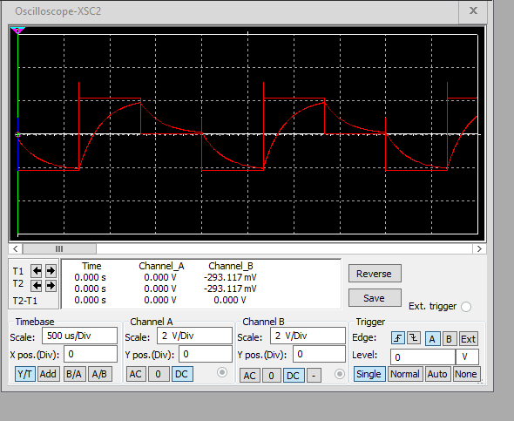
Pulse Code Modulation (PCM)
The first screenshot should show the Oscilloscope-XSC1 display with the analog input signal and sampling clock at the input to the ADC. The second screenshot should show the Oscilloscope-XSC2 display with the output of the DAC.
What are the effects of increasing or decreasing the sampling rate?
Answer: Increasing the sample rating also increases the signal fidelity but required more processing. Decreasing the sample rating decrease the signal fidelity which leads to data loss but requires less processing.

Slide 9
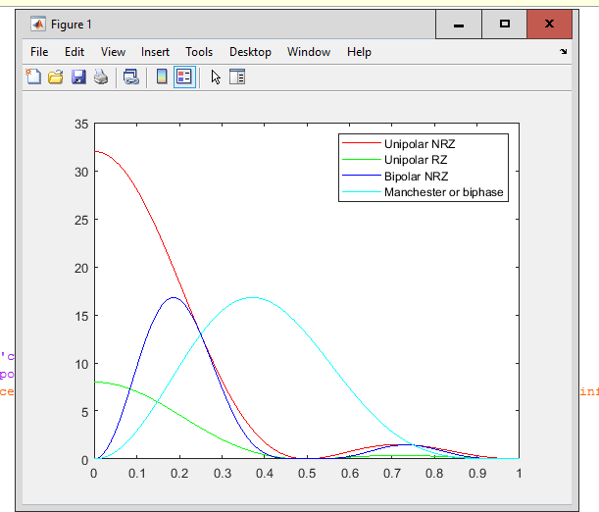
Line Codes
This screenshot should show the power spectral densities of four-line codes: NRZ-Polar, NRZ-Unipolar, NRZ-Bipolar, and Manchester-Polar.
MATLAB Diagram Here
Compare the NBR-Polar and Manchester polar codes in the diagram.
Which one requires more bandwidth?
Answer:
From my observation the Manchester polar codes requires more bandwidth.

Slide 10
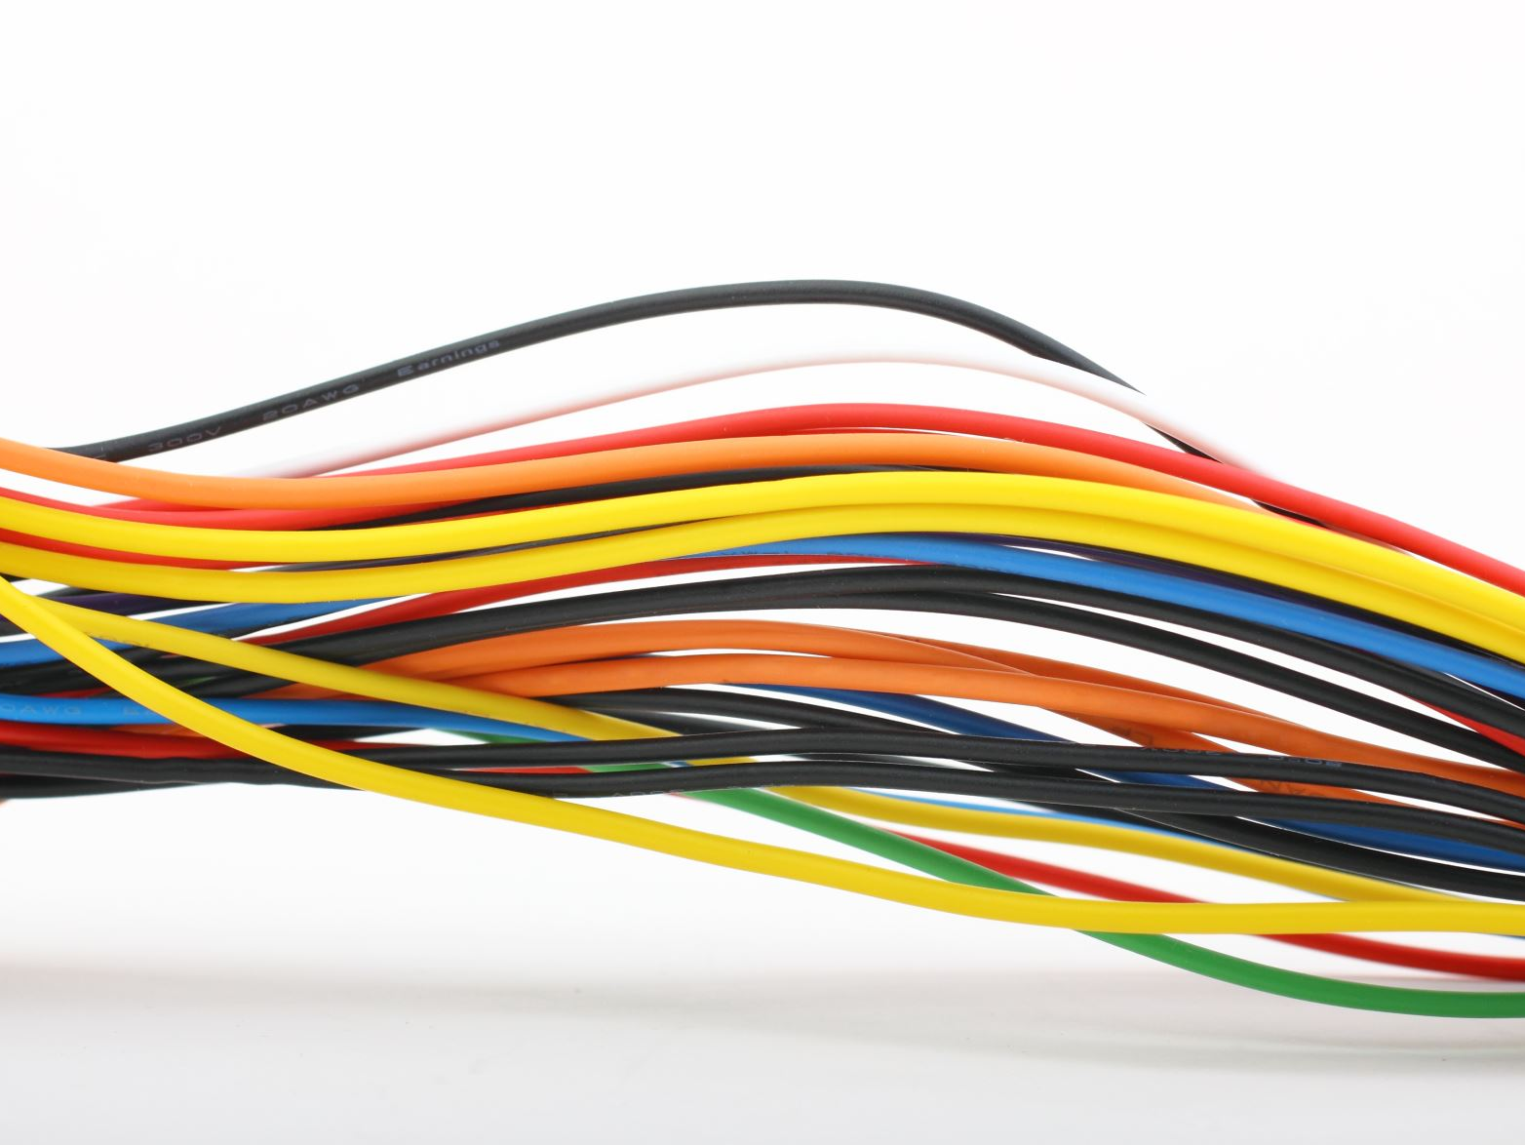
Cables and Structured Cabling
(Knowledge Check)

Slide 11
Questions
1. Why must the twisting in the individual wires be maintained in a UTP cable?
Answer:
It’s meant to reduce crosstalk EMI (electromagnetic interference).
2. How many inches should UTP cable be separated from 110 volts electrical cable?
Answer: 12 inches of separation.
3. Horizontal cabling connects what areas to each other?
Answer: the work area to the telecommunication room.

Slide 12
Questions
4. What is a plenum rated cable?
Answer: they have special insulation which is heat resistant with a low chance of smoke and flame.
5. What is a riser tube used for?
Answer: to move information between different floors.
6. Is the grounding of equipment mostly a safety or a performance concern?
Answer: Allow the fault current to have a safe path and help the system to not have unwanted electricity.

Slide 13
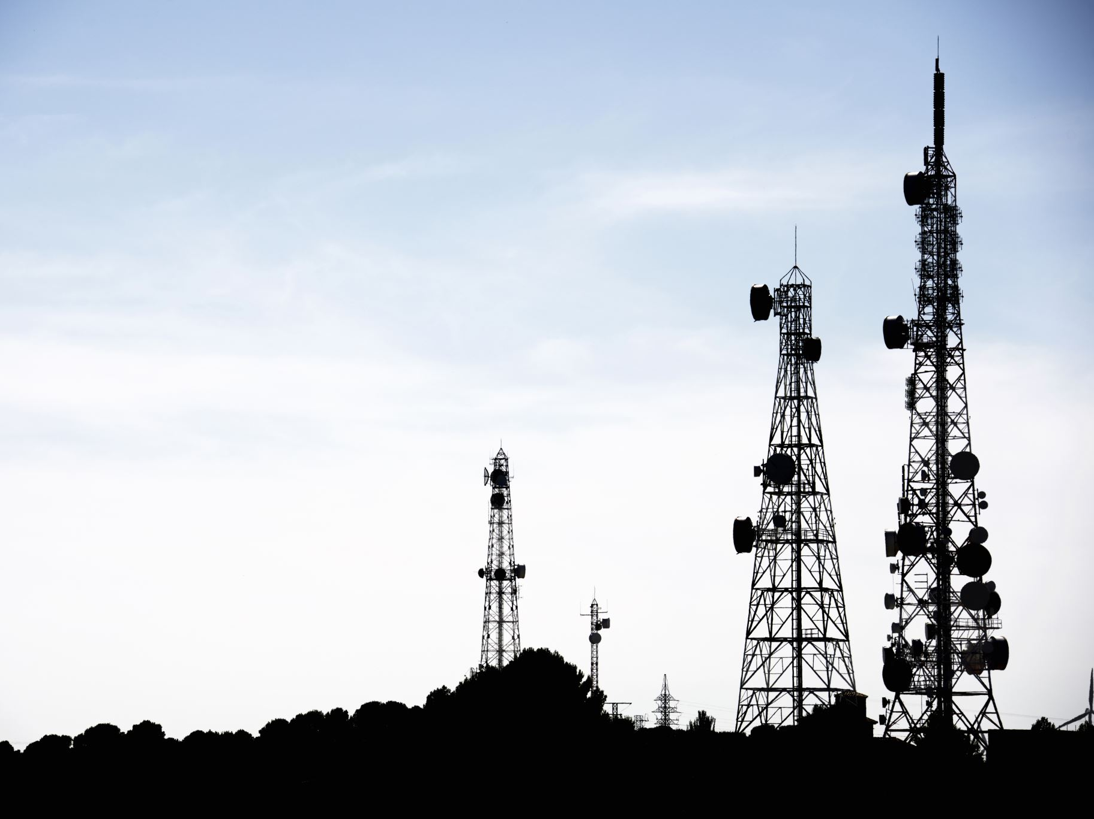
Antenna Gain and Free Space Path Loss
(Knowledge Check)

Slide 14
Antenna Gain
1. What is the maximum theoretical antenna gain of a common dish antenna at the 2.4 GHz band? [4 points]
Answer: 43cm dish antenna max gain would be 21.069 dB
2. What is the maximum theoretical antenna gain of a common dish antenna at the 5 GHz band? [4 points]
Answer: 43cm dish antenna max gain would be 27.769 dB
3. Given the same sized reflector, which signals, high-frequency, or low-frequency, can be more efficiently focused by a common dish antenna (i.e., result in a higher antenna gain)? [5 points]
Answer: High-Frequency
4. What is the maximum theoretical antenna gain of the dish antenna used in the VLA radio telescopes in New Mexico at the 5 GHz band? [4 points]
Answer: 63.059 dB
5. Given the same signal frequency, which dish antennas, large-sized or small-sized, are more efficient at focusing the signal (i.e., result in a higher antenna gain)? [5 points]
Answer: Large-szed

Slide 15
Free Space Path Loss
1. What is the free space path loss in dB at the 2.4 GHz band? [4 points] Answer: 46 dB
2. What is the free space path loss in dB at the 5 GHz band? [4 points] Answer: 53 db
3. How does the free space path loss at a higher frequency (e.g., the 5 GHz band) compare with that at a lower frequency (e.g., the 2.4 GHz band)? [5 points]
Answer: higher frequency has a higher chances of path loss compared to low frequency.
4. What is the free space path loss in dB over 20 meters at the 2.4 GHz band? [4 points]
Answer: 66.421 dB
5. What is the free space path loss in dB over 40 meters at the 2.4 GHz band? [4 points]
Answer: 72.441 dB
6. What is the free space path loss in dB over 80 meters at the 2.4 GHz band? [4 points]
Answer: 78.462 dB
7. When the distance doubles, how does free space path loss in dB change approximately? [5 points]
Answer: +6.02 dB

Slide 16
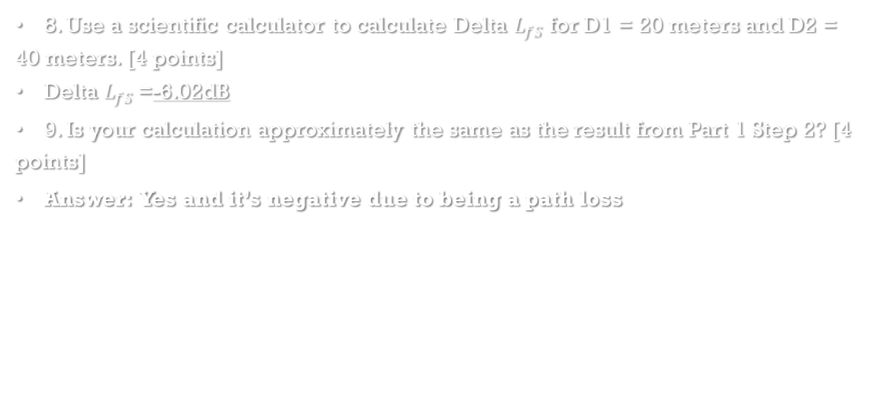
Free Space Path Loss Cont.
8. Use a scientific calculator to calculate Delta $L_{fS}$ for D1 = 20 meters and D2 = 40 meters. [4 points]
Delta $L_{fS }$=-6.02dB
9. Is your calculation approximately the same as the result from Part 1 Step 2? [4 points]
Answer: Yes and it’s negative due to being a path loss

Slide 17

Bit Error Rate of Fading Channels

Slide 18
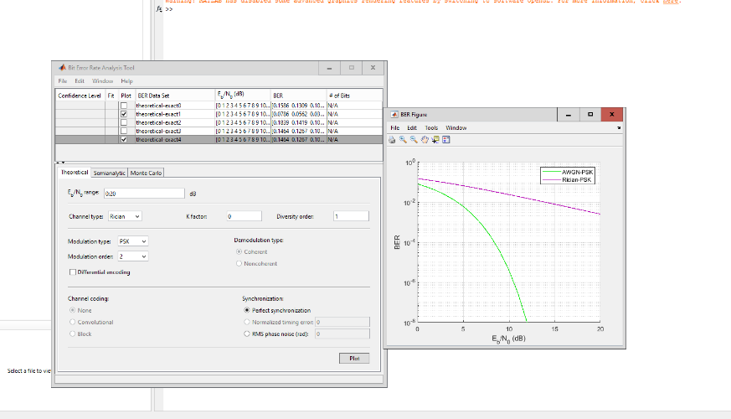
AWGN Channel and Rician Channel
This screenshot should show the bit rate error performance of both AWGN and Rician fading channels.

Slide 19
AWGN Channel and Rician Channel
Compare and contrast the BER performance of PSK over a noise limited (AWGN) transmission channel to the performance of PSK over a Rician channel at 5- and 10-dB Signal to Noise Ratio (E_{b}/N₀), respectively.
Is there a significant difference in BER performance of PSK between the AWGN channel and Rician channel?
Answer: Rician has a less of a drop-off compared to AWGN, so yes there is a difference.

Slide 20
References
Bhowmik, B., Quqa, S., Sause, M. G. R., Pakrashi, V., & Droubi, M. G. (1970, January 1). Data reduction strategies. SpringerLink. https://link.springer.com/chapter/10.1007/978-3-030-72192-3_9
Purpose of the ANSI/TIA/EIA-568-B standard - Anixter. (n.d.). https://web.anixter.com/AXECOM/AXEDocLib.nsf/(UnID)/8F2E0839A6190F4986257309005757CC/$file/ANSI-TIA-EIA-568-B.pdf
Scarpati, J., & Gerwig, K. (2023, March 29). What is an unshielded twisted pair (UTP)? - definition from whatis.com. Networking. https://www.techtarget.com/searchnetworking/definition/Unshielded-Twisted-Pair#:~:text=The%20two%20individual%20wires%20in,which%20can%20degrade%20network%20performance.
System and equipment grounding safety - technical articles. EEPower. (n.d.). https://eepower.com/technical-articles/system-and-equipment-grounding-safety/#
Harrington, R. F. (1960). Effect of antenna size on gain, bandwidth, and efficiency. Journal of Research of the National Bureau of Standards, Section D: Radio Propagation, 64D(1), 1. https://doi.org/10.6028/jres.064d.003

